Slide 1
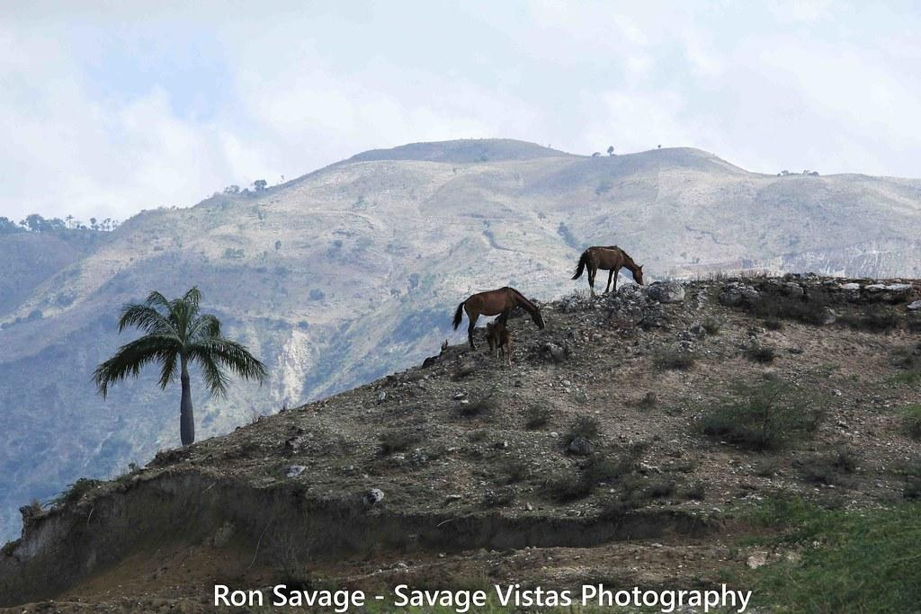
Deforestation
Derick Recinos

Slide 2
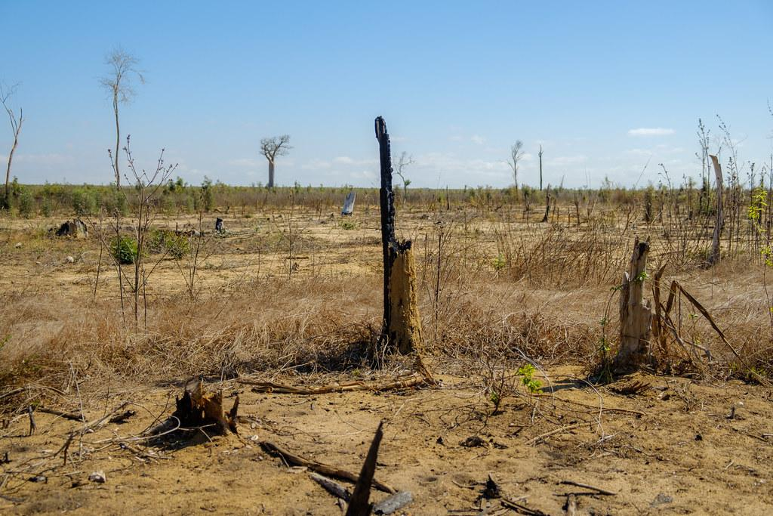
What is Deforestation
Deforestation is the clearing or thinning of forests

Slide 3
How does Deforestation affect us ?
Pros:
It creates more usable land
It creates opportunities for new jobs and opportunities for new developments
It creates some of the products we use
Cons
It causes climate problems
It costs us natural resources
Can lead to flooding or soil erosion

Slide 4
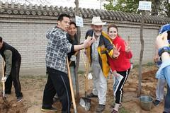
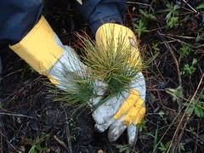
What can you do to help?
Recycle and reuse
Make more environmentally friendly choices
Plant a tree if you can !

